Slide 1
The longing of the soul
Anna Page, Seminarian

Slide 2
Advent
Beginning of liturgical calendar
Time of waiting, anticipation
Liminal space (already but not yet)
Pre-Monarchy = chaotic, disordered, longing

Slide 3
“Seek and serve Christ in all persons, loving our neighbors as ourselves” (Bcp, 305) and “restore all people to unity with god and each other in Christ” (bcp, 855)

Slide 4
outline
Definitions
Manifestations
Soul Care
Soul Repair

Slide 5
“The human spirit will endure sickness; but a broken spirit—who can bear?” (Proverbs 18:14)
WHAT IS MORAL INJURY?

Slide 6
TWO MAIN CAUSES:
EXTERNAL
PERSONAL
betrayal by “someone who holds legitimate authority in a high-stakes situation”
OR
“seeing someone else violate core moral values.”
Personally perpetrating, witnessing, or not preventing “acts that transgress [one’s] own moral and ethical values or codes of conduct”

Slide 7
Process: the road to moral injury
Moral Stress
Moral Fatigue
Moral Injury
Moral Disengagement
Moral Regression

Slide 8
Moral injury =/= ptsd
Source: Huffington Post

Slide 9
MANIFESTATIONS OF MORAL INJURY

Slide 10
MILITARY
“I felt betrayed by the government, the military leadership…and my faith community.”
“I love you and trust you only…trust is essential – I don’t know who to trust anymore.”
“I strive each day to forgive and absolve myself of guilt, and to live with the wounds of war that will never heal.”
“How do I handle having killed ‘nice’ people?”
“How can I forgive myself? Will God ever forgive me?”
“I don’t know if God forgives me. I feel like I committed a crime. A great sin.”
“I was told to shoot everything that moved but grew up believing and hearing that murder is bad. I killed anyways.”
What do we hear in each of these statements?

Slide 11
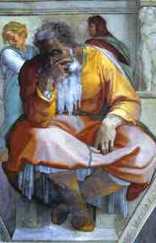
jeremiah
15 “O Lord, you know; remember me and visit me, and bring down retribution for me on my persecutors. In your forbearance do not take me away; know that on your account I suffer insult. 16 Your words were found, and I ate them, and your words became to me a joy and the delight of my heart; for I am called by your name, O Lord, God of hosts. 17 I did not sit in the company of merrymakers, nor did I rejoice; under the weight of your hand I sat alone, for you had filled me with indignation.18 Why is my pain unceasing, my wound incurable, refusing to be healed? Truly, you are to me like a deceitful brook, like waters that fail.”
(Jeremiah 15:15-18)
What do we hear in these verses?
Image: “The Prophet Jeremiah,” Michelangelo

Slide 12
Psalm 42
1 As a deer longs for flowing streams,
so my soul longs for you, O God.
2 My soul thirsts for God,
for the living God.
When shall I come and behold
the face of God?
3 My tears have been my food
day and night,
while people say to me continually,
“Where is your God?”
4 These things I remember,
as I pour out my soul:
how I went with the throng,[a]
and led them in procession to the house of God,
with glad shouts and songs of thanksgiving,
a multitude keeping festival.
5 Why are you cast down, O my soul,
and why are you disquieted within me?
Hope in God; for I shall again praise him,
my help 6 and my God.
My soul is cast down within me;
therefore I remember you
from the land of Jordan and of Hermon,
from Mount Mizar.
7 Deep calls to deep
at the thunder of your cataracts;
all your waves and your billows
have gone over me.
8 By day the Lord commands his steadfast love,
and at night his song is with me,
a prayer to the God of my life.
9 I say to God, my rock,
“Why have you forgotten me?
Why must I walk about mournfully
because the enemy oppresses me?”
10 As with a deadly wound in my body,
my adversaries taunt me,
while they say to me continually,
“Where is your God?”
11 Why are you cast down, O my soul,
and why are you disquieted within me?
Hope in God; for I shall again praise him,
my help and my God.
What do we hear in this psalm?

Slide 13
SOUL CARE & SOUL REPAIR

Slide 14
Soul care = Prevention
Grapple with the existence of evil
Pre-determine personal capacity to participate in evil
Pre-determine ethics and morals; workshop dilemmas
Spiritual practices/disciplines
Therapy/Counseling
Identity

Slide 15
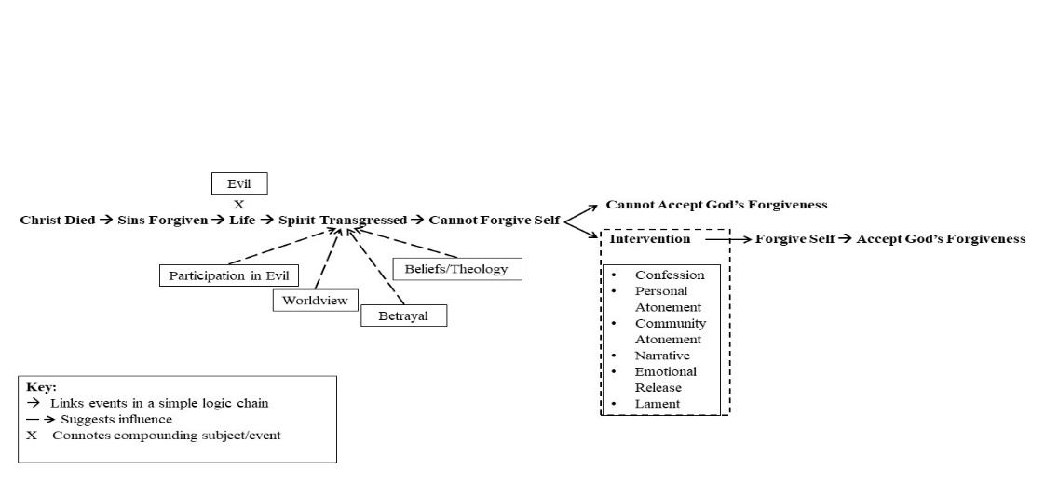
Soul repair

Slide 16
Questions
David Peters, Post-Traumatic God: How the Church Cares for People Who Have Been to Hell and Back
Adam Tietje and Deborah van Deusen Hunsinger, Toward a Pastoral Theology of Holy Saturday: Providing Spiritual Care for War Wounded Souls
Rita Nakashima Brock and Gabriella Lettini, Soul Repair: Recovering from Moral Injury after War
David Blumenthal, Exploring Moral Injury in Sacred Texts
Bryan Doerries, The Theater of War: What Ancient Greek Tragedies Can Teach Us Today
Jonathan Shay, Achilles in Vietnam: Combat Trauma and the Undoing of Character
Jonathan Shay, Odysseus in America: Combat Trauma and the Trials of Homecoming
Phil Klay, Redeployment
Tim O’Brien, The Things They Carried
?

