Slide 1
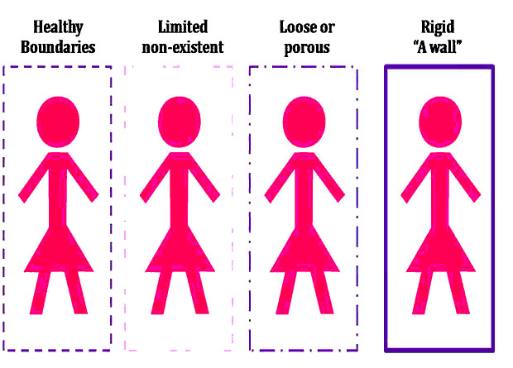
People Leading People Lunch & Learn Series
Session 3 – Healthy Boundary Setting: Setting and Managing Expectations
CH (CPT) Anna S. Page
19 August 2022

Slide 2
Outline
Boundaries Defined
Why Set Boundaries?
Setting Boundaries
Communicating Boundaries
Looking Ahead
Norms
Respect (self, others)
Participation (3 takeaways)
Willingness to Learn

Slide 3
Word Association: Boundaries
What comes to mind when you hear the word boundary? What do you think a boundary is, and what do you think a boundary isn’t?

Slide 4
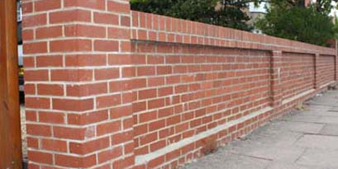
Word Association: Boundaries
What comes to mind when you hear the word boundary? What do you think a boundary is, and what do you think a boundary isn’t?

Slide 5
Boundaries: What are they?
Healthy Boundaries = physical, mental, and emotional limits that are set to ensure mental and emotional stability and to protect ourselves from being manipulated, used, or violated by others (paraphrased by Prism Health North Texas, n.d)
Categories:
Emotional
Physical
Intimate
Workplace
Material
Time

Slide 6
Boundaries: What are they?
Healthy Boundaries = physical, mental, and emotional limits that are set to ensure mental and emotional stability and to protect ourselves from being manipulated, used, or violated by others (paraphrased by Prism Health North Texas, n.d)
Valuing own opinion
Not compromising on values
Appropriate level of sharing
Knowing own needs
Open communication
Accepting others’ boundaries

Slide 7
Boundaries: What are they?
Personal Boundaries = “the limits and rules we set for ourselves within relationships” (Berkeley)
Professional Boundaries = “the limits and rules we set for ourselves within [working] relationships” + the “limits to the relationship between ourselves in a professional role and the person(s) for whom we are responsible”
For yourself
focusing here
With those for whom responsible

Slide 8
Why Boundaries?
Why do you think knowing and communicating our own boundaries is important?

Slide 9
Why Boundaries?
“When we fail to set boundaries and hold people accountable, we feel used and mistreated.” ― Brené Brown
Poor Boundaries:
Healthy Boundaries:
Overwork
Mismanaged priorities
Unclear expectations
Poor communication and/or misunderstanding
Resentment
Poor overall health
Unnecessary stress & potential for burnout, quitting, existential harm
Connection
Trust
Appropriate behavior
Respect
Effective communication
Efficient working conditions and increased focused
Expectation Management
Clearly delineated relationships
Mitigated stress
Mission Command

Slide 10
Setting Boundaries
Generally:
Know
Yourself (values, triggers, needs)
You have a right to personal boundaries
Define
Your line: physical, verbal, emotional, space
“okay” and “not okay”
Communicate
Tell necessary parties
Express why
Trust
You are the expert on you

Slide 11
Setting Boundaries
Generally:
Know
Yourself (values, triggers, needs)
You have a right to personal boundaries
Define
Your line: physical, verbal, emotional, space
“okay” and “not okay”
Communicate
Tell necessary parties
Express why
Trust
You are the expert on you
Professionally: the above + Clear delineation and expectations

Slide 12
Setting Boundaries
What are some examples of healthy boundaries that could be set in the workplace?

Slide 13
Setting Boundaries
Time:
Communication:
Prioritization:
Office Hours
Limits
Calendar
Office Norms
Channels/Hierarchy
Availability (phone, emails)
Signature Block
Topics of discussion/Language used
Systematize
Autoresponder
Manage your plate
Honesty
Communicate
Expectations
Personal Space:
Relationships:
Turn off phone
Take leave/break
Delineate
Customs & Courtesies

Slide 14
Setting Boundaries
Tools:
Doctrine/Regulations/Policies
Programs: EO, SHARP, IG
Army Values
Personal Code of Ethics/Values
How do you think these tools help us establish healthy boundaries?

Slide 15
Communicating Boundaries
Tips:
Coordinate with whoever needs to approve your flow
Post signs/publicize how to reach you
Email signature block
Openly discuss your boundaries with your boss, coworkers, subordinates
Communicate why → why need and why important to you
What do you think are some effective ways that you could communicate your boundaries in your personal and professional relationships?

Slide 16
Communicating Boundaries
Responding when our boundaries are crossed:
Necessity:
Accidentally:
Purposefully:
Sometimes necessary
Engage coping strategies/self-care after mission
Discern w/ boss emergency vs. perceived emergency (as appropriate)
If you are asking someone to violate boundaries, be courteous
Accidents happen
Breathe, slow down
Address boundary violation right away
Communicate your boundary and ensure clarity
Repeated violations =/= accident
Communicate & document
Engage help (report, as feel is needed)

Slide 17
Conclusion
Questions?
Takeaways x 3
Next session:
MS Teams
14 September, 1200-1300 GMT +2
Empathy: Knowing Your Soldiers, Knowing Yourself, and Building Trust

