Slide 1
People Leading People Lunch & Learn Series
Session 1 – Identifying Stress: Is It a Crisis or Is It Discomfort?
CH (CPT) Anna S. Page
13 June 2022

Slide 2
Outline
Stress, Discomfort, Crises
Why Distinguish These
Navigating Stress
Looking Ahead

Slide 3
Consider…
How would you define these three words: stress, crisis, and discomfort?

Slide 4
Consider…
As an individual, how do you think you handle stress?
As a team, how do you think we handle stress?

Slide 5
Stress
Eustress
Discomfort
Distress
Crisis

Slide 6
Consider…
When you hear crisis, what are some examples that come to mind? How does this differ from discomfort?

Slide 7
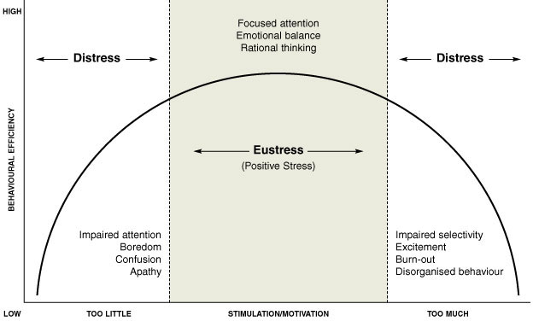
Adaptation of the Yerkes-Dodson curve (Dr. John Warren)

Slide 8
Where we want to be
Adaptation of the Yerkes-Dodson curve (Dr. John Warren)

Slide 9
Where we often find ourselves
Where we want to be
+ Fight/Flight/Freeze
+ Fight/Flight/Freeze
Adaptation of the Yerkes-Dodson curve (Dr. John Warren)

Slide 10
Discomfort
Discomfort
Crisis
Crisis
Where we often find ourselves
Where we want to be
+ Fight/Flight/Freeze
+ Fight/Flight/Freeze
Adaptation of the Yerkes-Dodson curve (Dr. John Warren)

Slide 11
Tips for Navigating Stress
Breathe
Identify that you are stressed, and the kind of stress (eustress vs. distress)
Identify if you are feeling uncomfortable & source of discomfort
Intervene
Plan
Get help, as needed
→ Goal: slow down enough to be able to process, respond well, grow
Iterative, non-liner

Slide 12
Conclusion
Takeaways x 3
Next session:
MS Teams
15 July, 1200-1300 GMT +2
Burnout: What Is It, How Do We Prevent It, and How Do We Navigate It?
Questions?

